Slide 1


ECEN 404
Team #44
Biweekly Update 4
Cubesat EM Material Discharge Eval:
Ian Poynter
Joshua Feldman
Michael Kim
Alejandro Torres
Sponsor: Orbital Arc & SATOP
TA: Souryendu Das

Slide 2
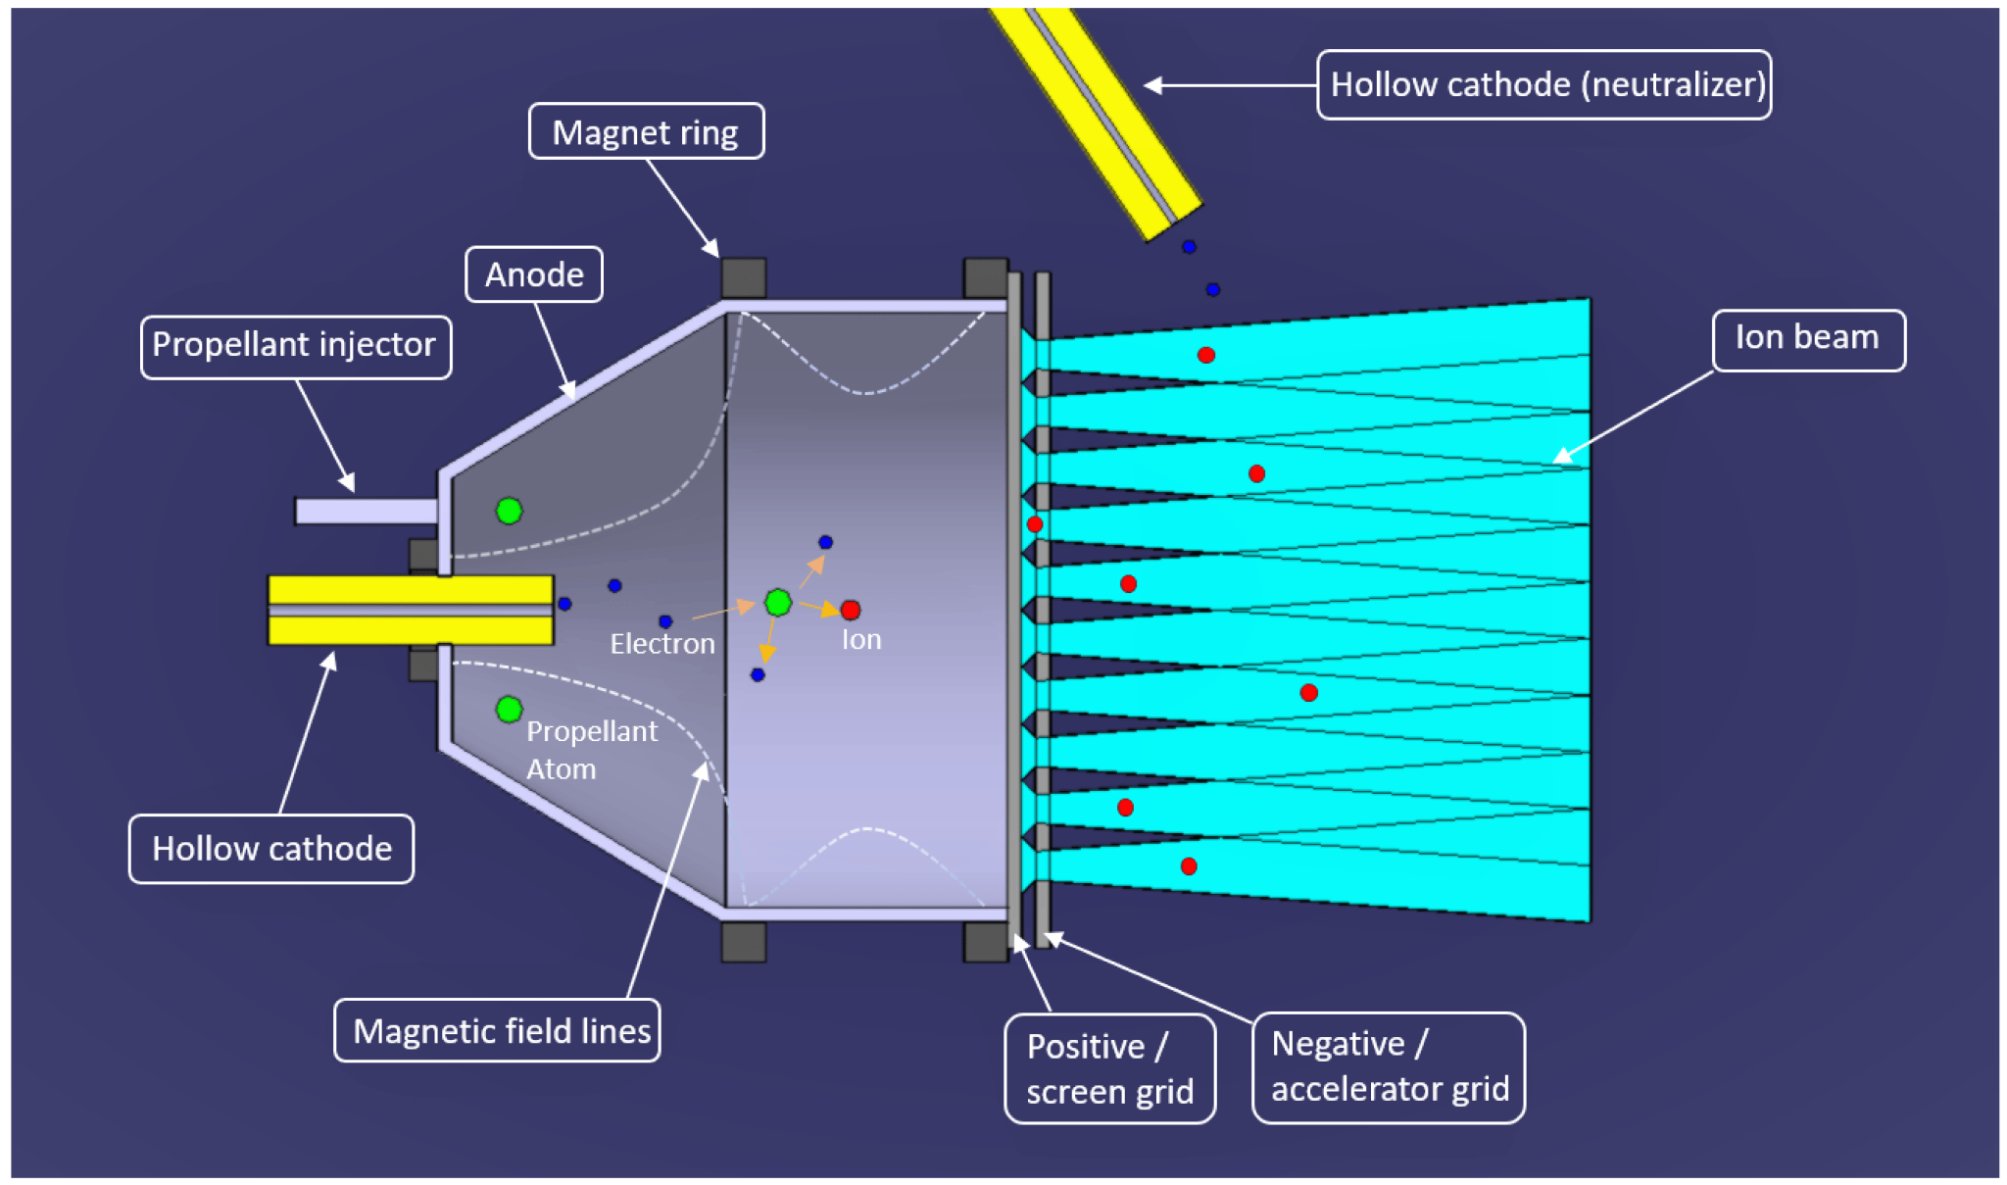
Problem Statement
Current Ion Thrusters have limited use cases due to many factors, including fuel cost and harsh ionization methods

Slide 3
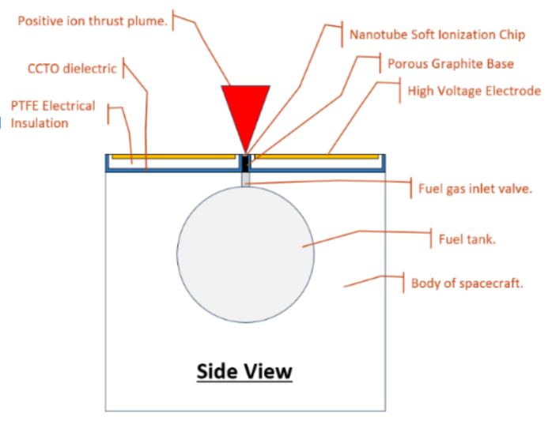
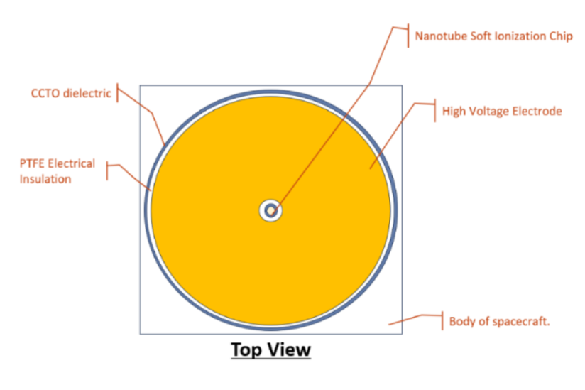
Project Summary
RIOT Drive: New type of Ion Thruster that will reduce these limitations and operate with higher efficiency
Solution
Develop a prototype for the RIOT Drive
Internal Hardware
Power Supply
Microcontroller
Accelerator Plate
Geometry Selection

Slide 4
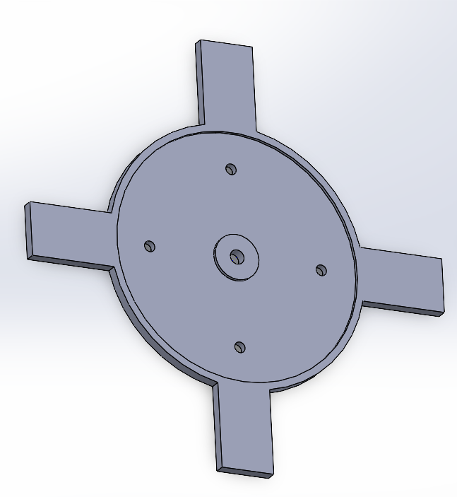
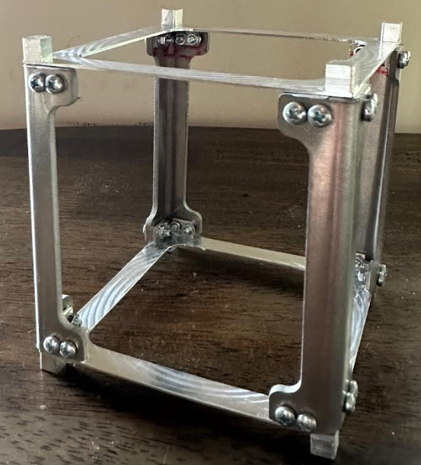
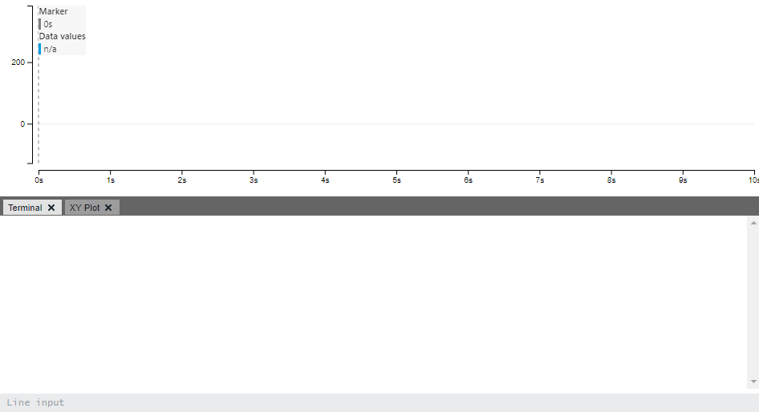
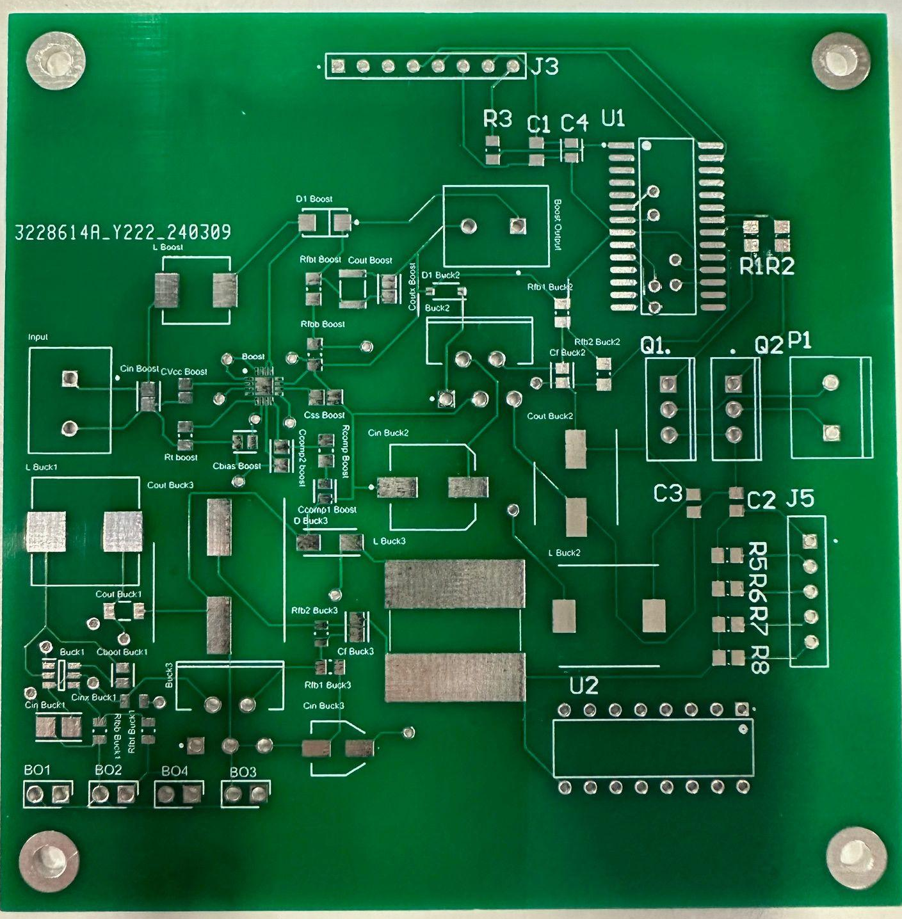
System Diagram
DC Power Supply
User Interface

Slide 5
Project Timeline
Mechanical Subsystems Design and Testing (completed 12/3) | Hardware Subsystems Redesign and Testing (to complete by 2/22) | Integration of Microcontroller and Power Subsystems (to complete by 3/18) | Component Selection for Accelerator Plate (to complete by 3/28) | Validation of Integrated Hardware (to complete by 3/28) | Final Integration (to complete by 4/12) | Final Demo (to complete by 4/19)

Slide 6
Power
Alejandro Torres
Accomplishments since last update 23 hrs of effort | Ongoing progress/problems and plans until the next presentation
E-load Tested the 24V - 5V buck converter Tested the Power PCB with the MCU to test its functionality with the buck converter Debugged PCBs boost converter on Altium Combined both the MCU and Power PCBs Ordered the PCB and necessary parts | Solder and test integrated PCB Debug any issues if needed

Slide 7
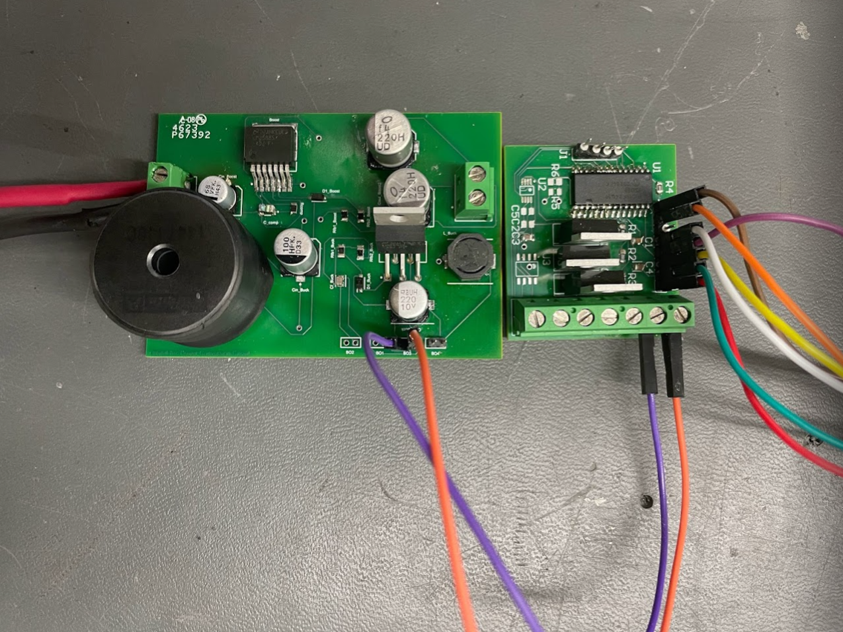
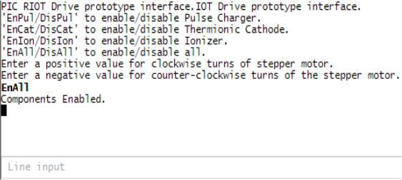
Microcontroller & Power Supply
24V to 3.3V Buck converter tested and validated with MCU.

Slide 8
Microcontroller
Joshua Feldman
Accomplishments since last update 28 hours of effort | Ongoing progress/problems and plans until the next presentation
Soldered reworked microcontroller board. Debugged and recoded microcontroller code. Tested microcontroller functionality with stepper motor driver. Tested and validated functionality with integration of Microcontroller and Power subsystems. Designed and ordered integrated power and microcontroller board that fits to Cubesat chassis mounting. | Work with Alejandro to solder and test integrated PCB after lab. Test stepper motor with gas flow valve and verify that valve opens and closes. Work with Ian to mount fully soldered PCB to chassis. Rework and reorder integrated board if needed.

Slide 9
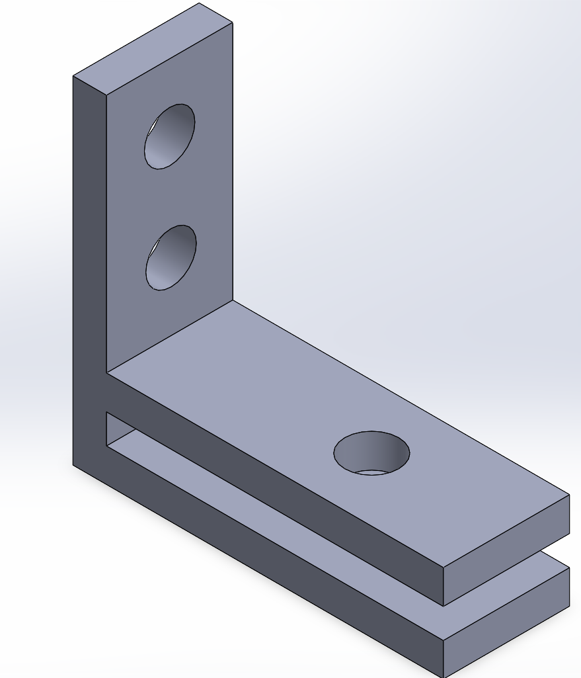
PCB Mounting
Ian Poynter
Accomplishments since last update 12 hrs of effort | Ongoing progress/problems and plans until the next presentation
Designed PCB mounting for chassis Fabricated prototype mounts Fabricated final mounts for integrated PCB | Fix mounting to chassis and ensure fit of PCB Mount and test soldered PCB

Slide 10
High Potential Accelerator Plate
Michael Kim
Accomplishments since last update 10 hrs of effort | Ongoing progress/problems and plans until the next presentation
Reviewed simulations data and calculated electric fields using Gauss’s Law Final prototype is selected Mounting for plate is designed | Re-fabricate plate for mounting

Slide 11
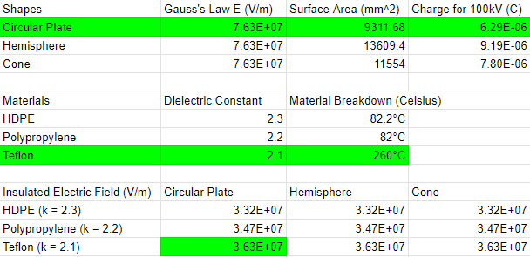
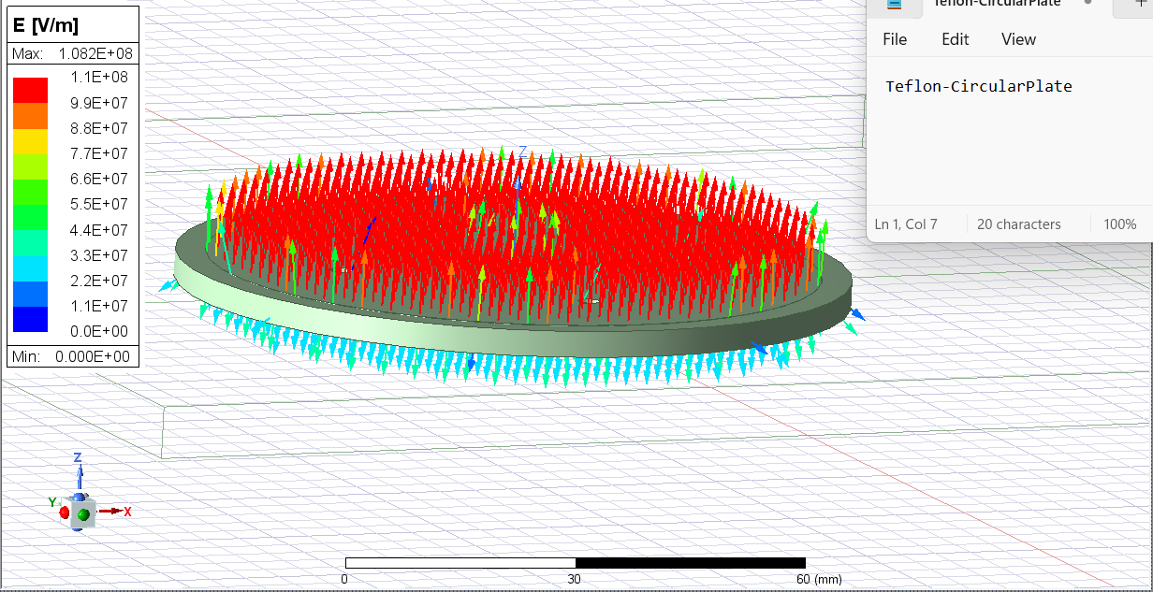
Teflon-Circular Plate

Slide 12
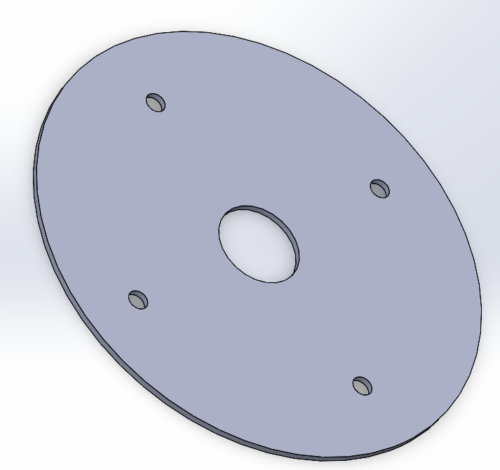

Slide 13
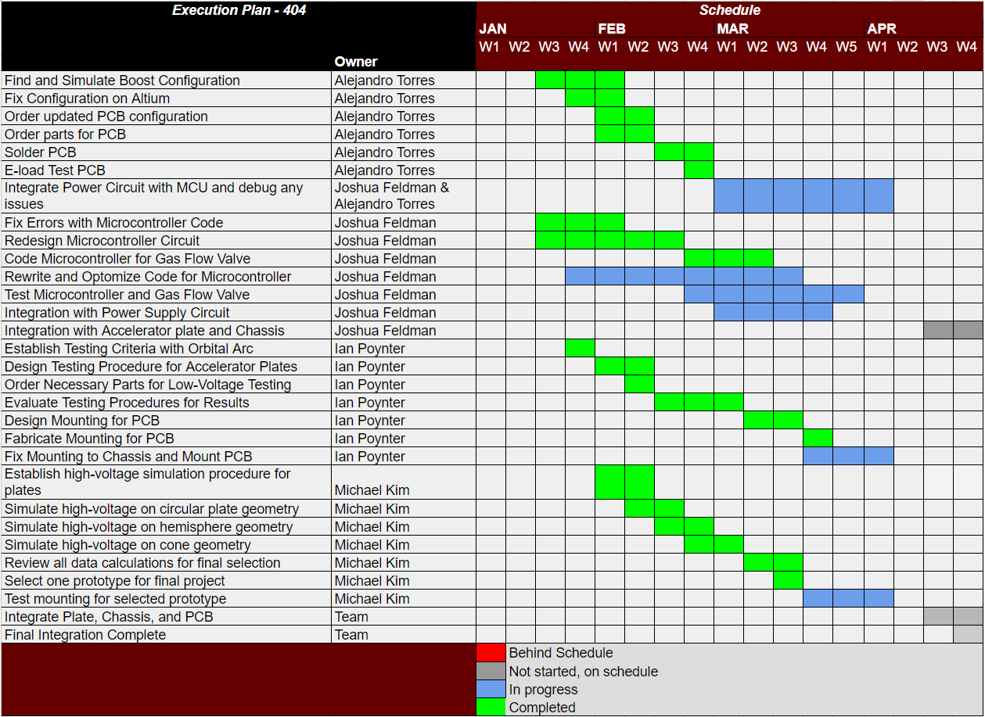
Execution Plan

Slide 14
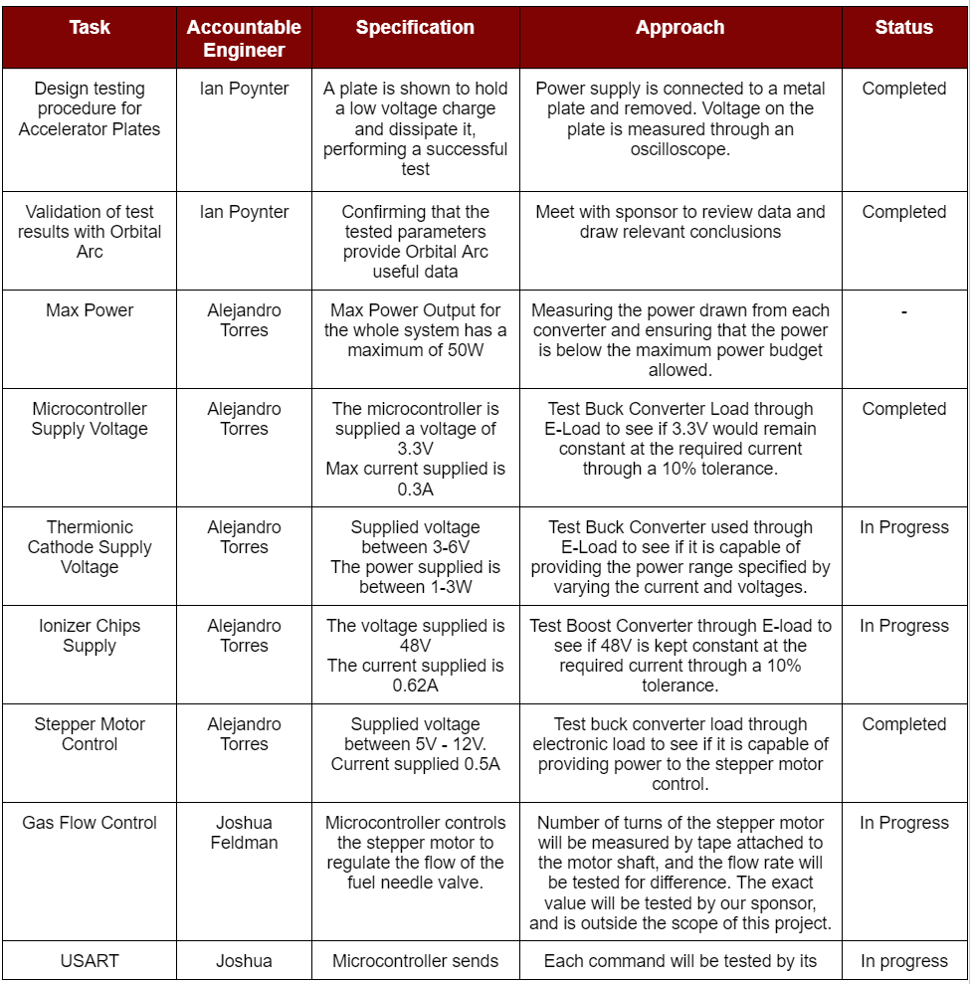
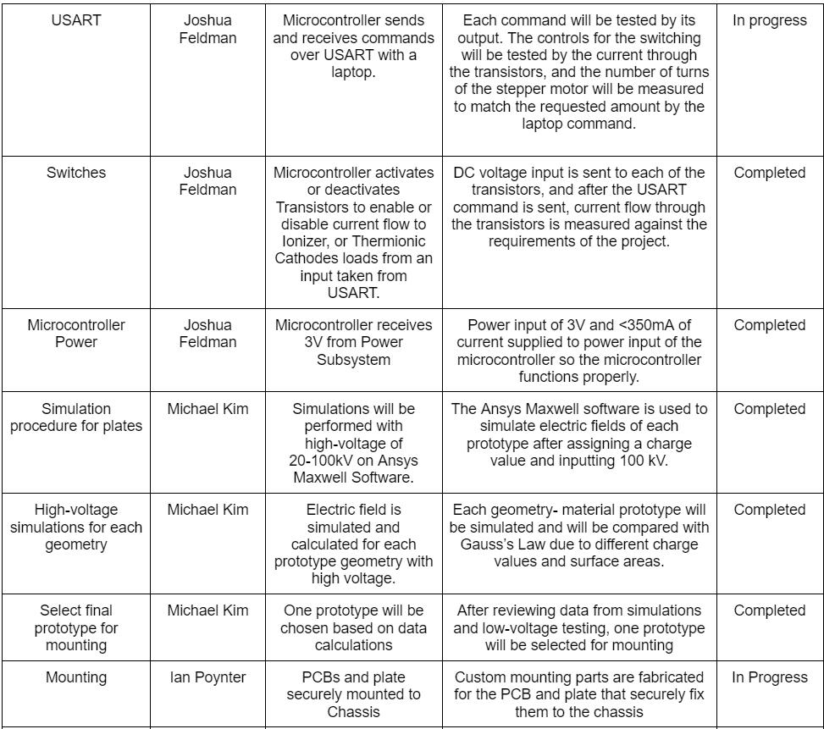
Validation Plan

Slide 15
Thank you!

